Slide 1



TRAINING DAY 5

Slide 2
AGENDA
Migration Cockpit Introduction
Migration Objects
Migration Using Templates
Migration Using Tables
Migration Object Modeler
Questions

Slide 3
Introduction to S4 HANA Legacy Transfer Migration Cockpit

Slide 4
S/4HANA Migration Cockpit-Purpose
S/4 HANA migration cockpit is the migration tool which was initially designed for S/4HANA on-premise & cloud edition.
S/4 HANA Migration Cockpit is browser based (WordPro) interface. No additional setup or activation is required once we setup SAP S/4HANA system.

Slide 5
Key Features of Migration Cockpit
This tool is embedded and delivered with S/4HANA system.
No programming is required by the customer.
As the name suggests, this tool is used for migrating data from SAP or Non SAP system to S/4HANA.
This tool has predefined migration object which contains the mapping for all master and transactional data. It reduces migration cost and time.
Migration activities are predefined and easy to use.
Advantages:
faster overall process (export/import), less clicks
Performance
Use Database Tools to Extract and Transform

Slide 6
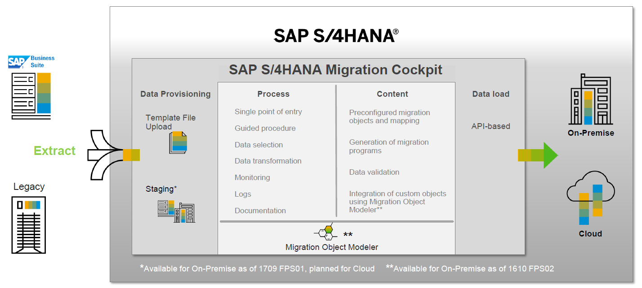
SAP S/4HANA Migration Cockpit –Overview Cloud 1808 / On-Premise 1809

Slide 7
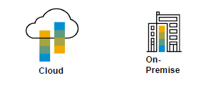

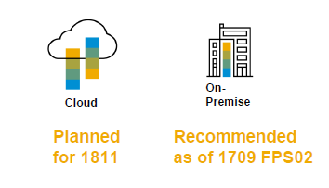


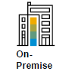
SAP S/4HANA Migration Cockpit –Migration Approaches
Transfer Data Using Files
Download template file for relevant migration object
Populate file with relevant business data
Upload file to the SAP S/4HANA migration cockpit
Transfer Data Using Staging Tables
Staging tables are created automatically (in an SAP HANA DB schema)
Populate staging tables with business data
Transfer data from staging tables to target SAP S/4HANA system
Transfer Data Directly from SAP Source System (planned)
Access source system database directly (ABAP-based SAP source systems only)
Transfer data from SAP source system to target SAP S/4HANA system
Supports data migration scenarios from other applications,
e.g. from SAP Apparel and Footwear (AFS) to S/4 Fashion and Vertical Business

Slide 8
SAP S/4HANA Migration Cockpit –File Upload –on-Premise Enhancements
Default size limit for each uploaded XML 100 MB.
If the file exceeds this limit, the message ‘File size too large’ is displayed.
If you need to upload larger files, there are two options:
-You can change a system parameter (icm/HTTP/max_request_size_KB​) to increase the size limit for each uploaded XML file to 160MB.
-You can zip several files together. Note that the combined size of all the XML files you want to add to the zip file must not exceed 160MB.Limit for zip file is still 160 MB with adjusted system parameter.

Slide 9
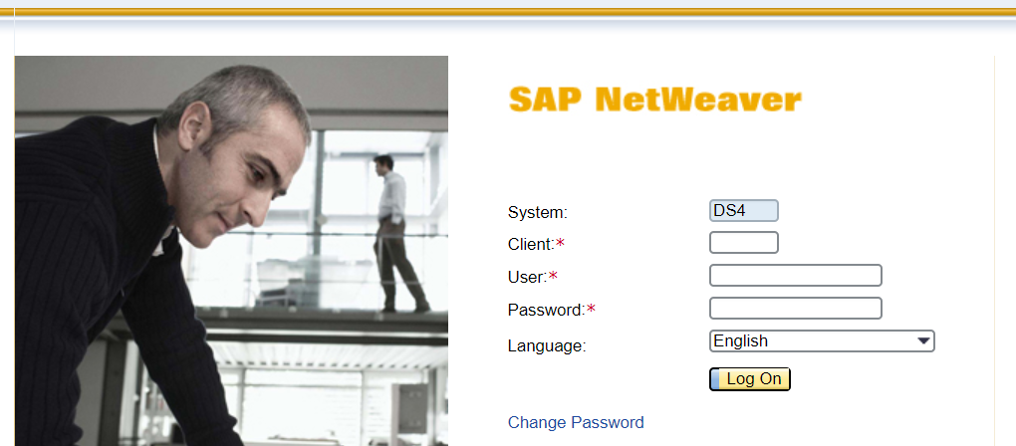
Cockpit tool Access:
We can access Cockpit tool in either URL or by using T-code LTMC in ERP. The below screen will be visible when you launch the Cockpit in either of above 2 ways .

Slide 10
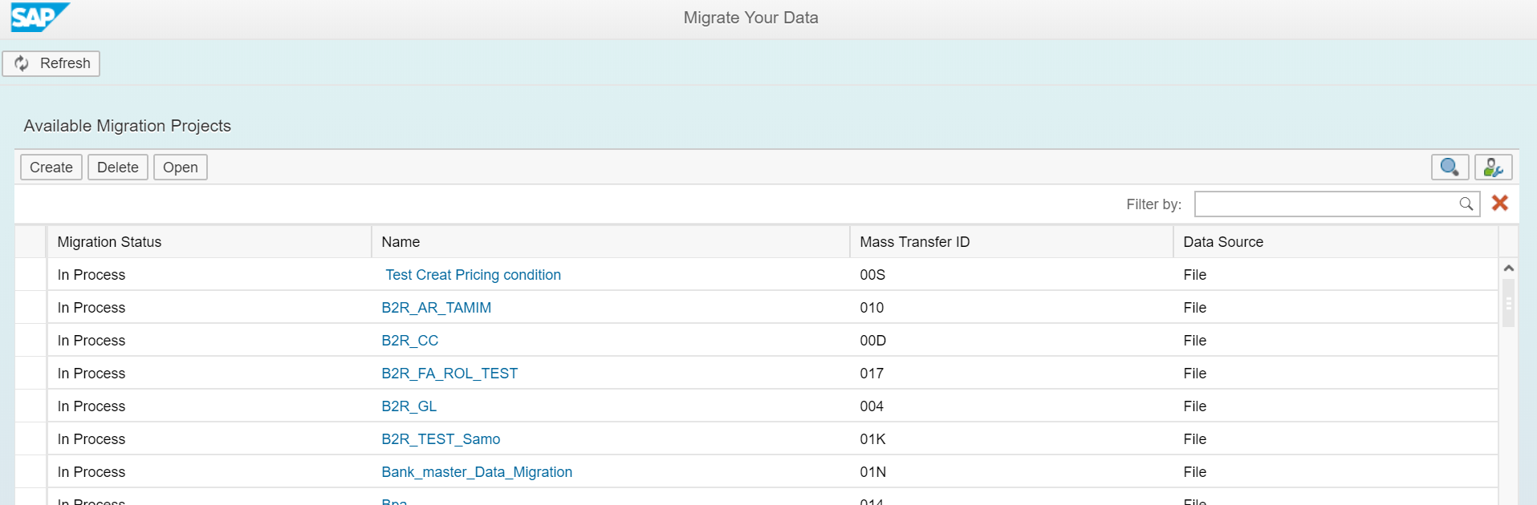
Once you login below screen will be visible with all available projects (or blank if new system)

Slide 11
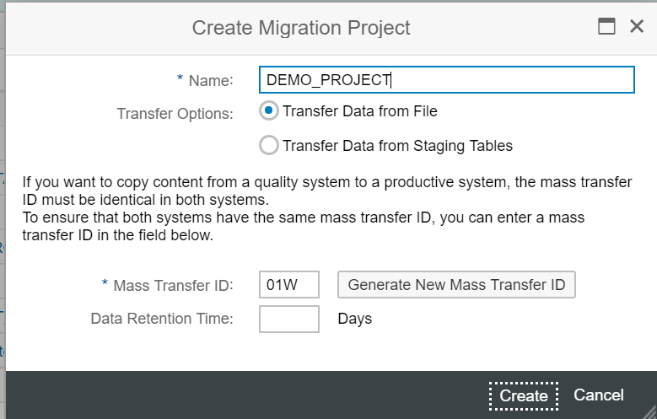
Creating a New Project for Data Migration:
Click on Create New Migration Object and Select the Transfer Option – Transfer data from file.

Slide 12
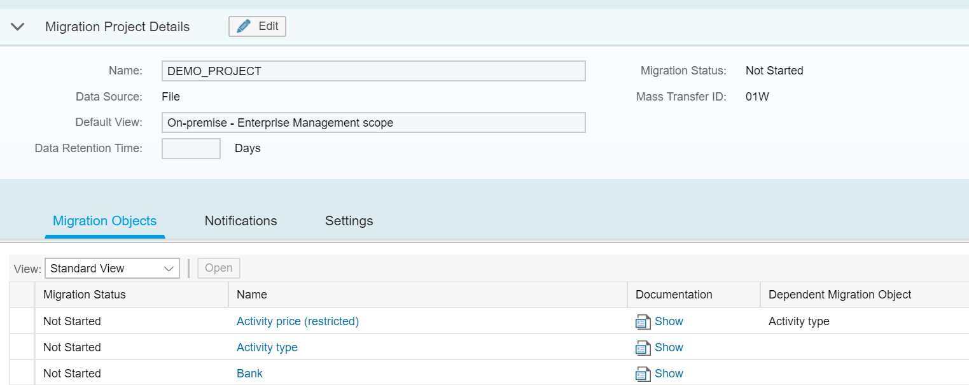
Click on DEMO_PROJECT and it will enter the Project with all Migration Objects available. Migration object comes with the following information:

Slide 13
Default Migration Object Auto Population with information:
1. Status– Object can be active – available for migration, deactivate – not available
for migration and started – migration has started on this object.
2. Object name– It is migration object name which is relevant to customer master or
transnational data.
3. Documentation– Once we click on documentation it will open a new window
where we can find all information on migration object like required structure,
fields, uses.
4. Dependent migration object– It shows a list of migration object that must be
loaded first or already present in the system.
You can see all Conversion Objects are in Status Not Started.

Slide 14
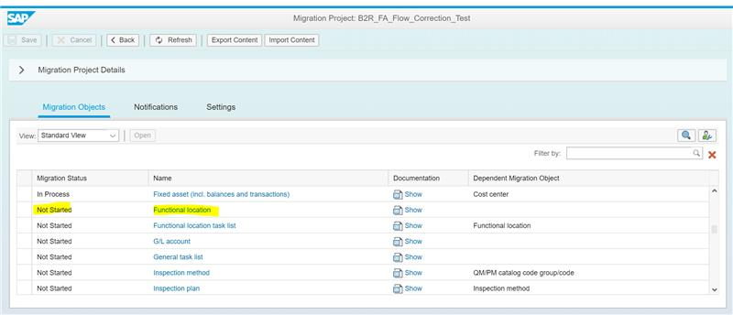
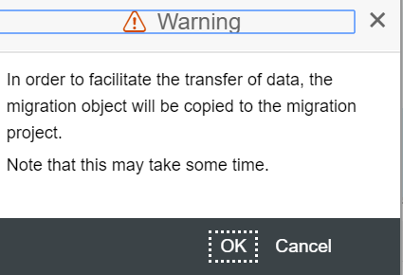
For this Demo we are using Functional Location Object. When you Click on Functional Location Conversion Object, a popup comes asking for copying the Conversion.
Click OK.

Slide 15
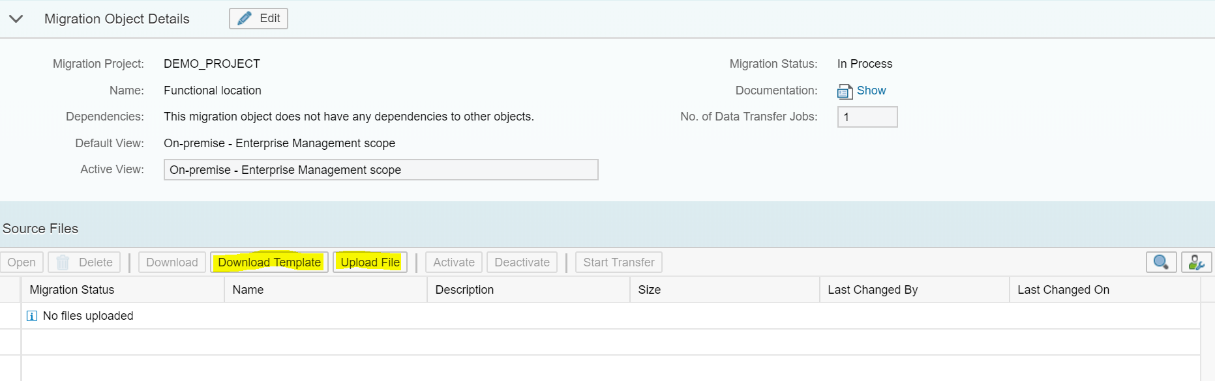

Slide 16
Migration Template overview:
Down-Load Template: From this window down load the template which you want to migrate . For example in our case we are migrating Functional location object.
Click on down load template ,one xml file will be downloaded this is called template object and fill the data in all mandatory tabs of template according to client business .
Now before uploading the file we will first focus on one template to understand
the structure of object and mandatory fields which needs to be fill the data for file upload .
A migration template (Microsoft Excel XML Spreadsheet 2003 file) consists of different sheets which are visible at the bottom of the migration template. You use the different sheets to specify the data that belongs to different data structures. For example the migration template for the migration object 'Material', contains a sheet for basic data, a sheet for plant data, and so on. Some sheets are mandatory, and some are optional.

Slide 17
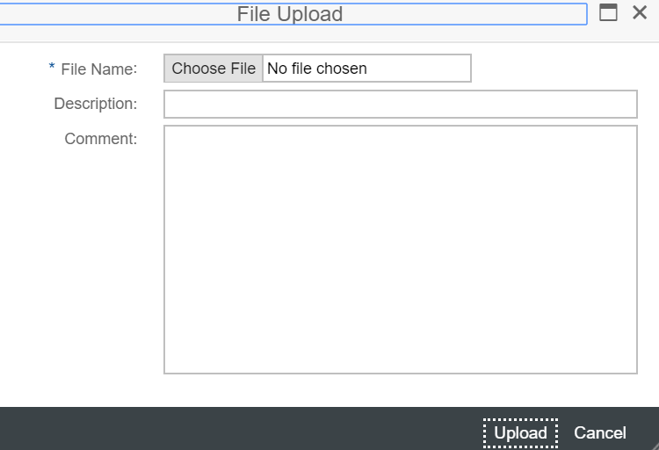
Uploading file:
In this example we are uploading Functional Location file .After downloading the template fill the data in it and upload .
Note: All the mandatory fields needs to be fill other wise file uploaded will be failed with errors. The data should be in SAP standard format. Below screen shows the file upload process.
When we click on upload file it will show below screen.

Slide 18
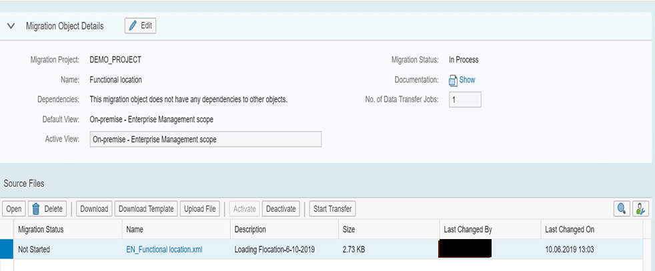
Click on upload then the below screen will be visible .
Select the below object click on activate button once activate button is disable then click on Start transfer tab.

Slide 19
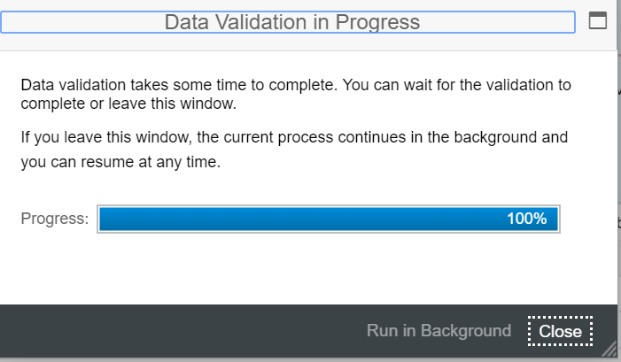
It will give the warning .Click ok
Close below window when you see 100%

Slide 20
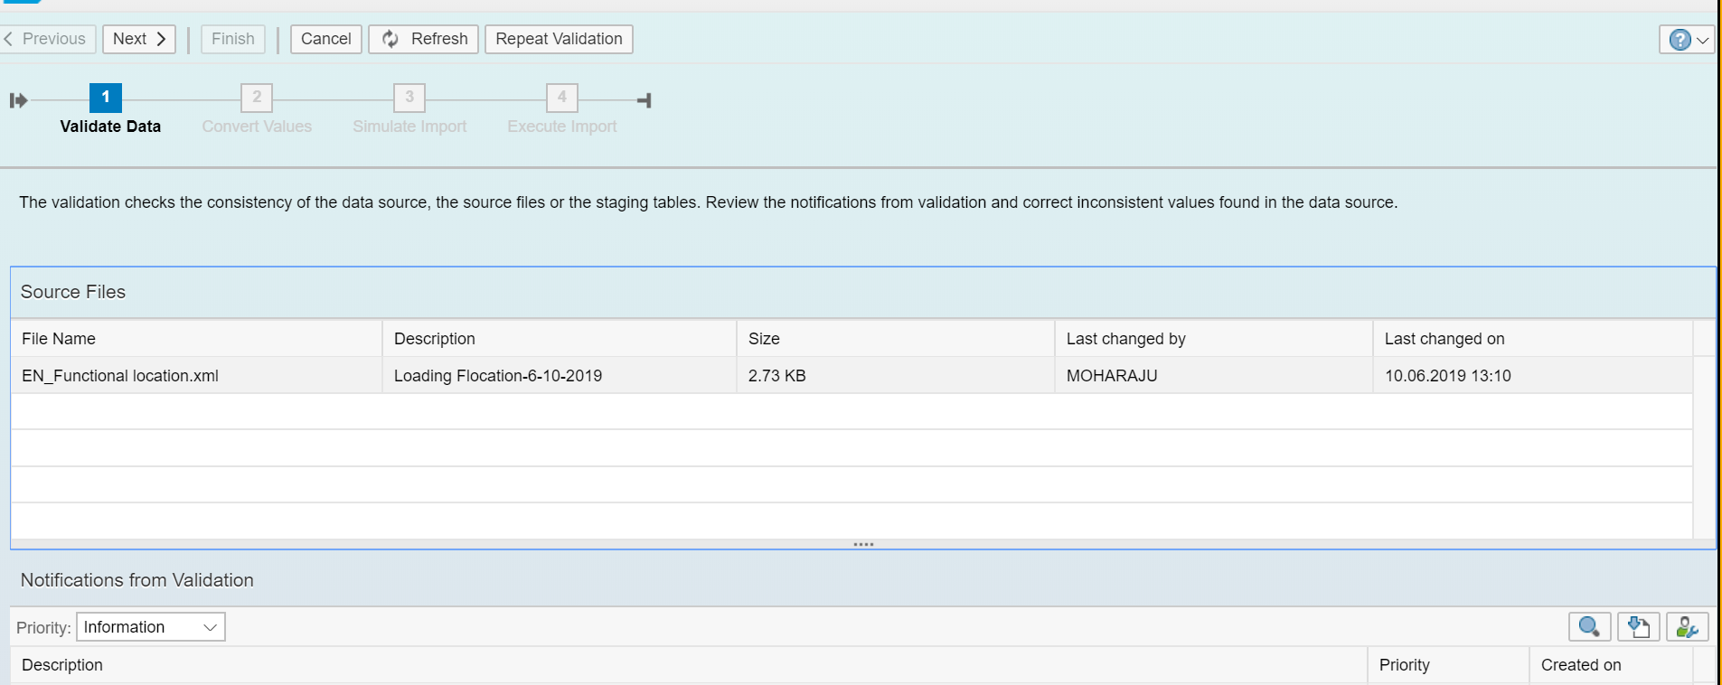
Click next in below screen:

Slide 21
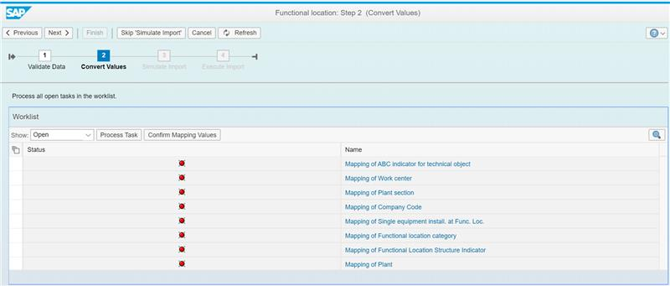
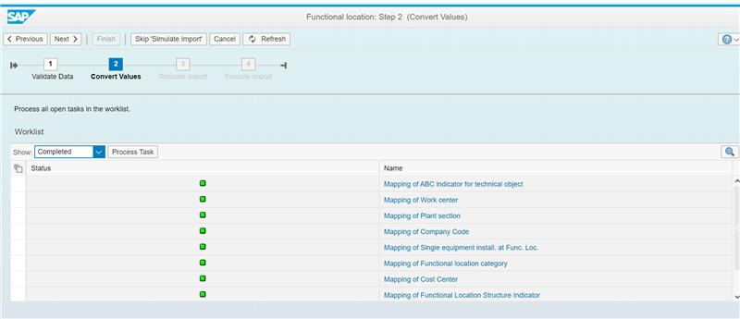
When we click on next in above screen it will move to convert values.

Slide 22
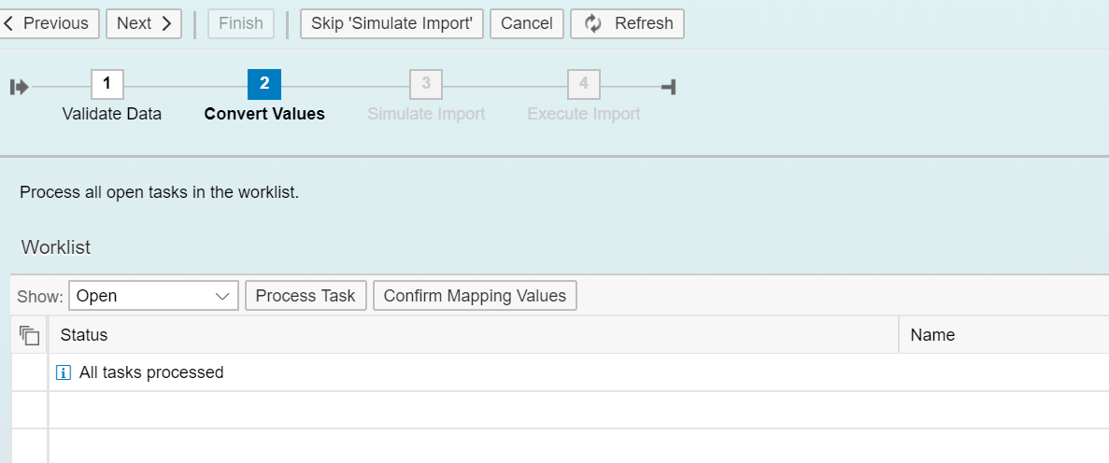
When we click on next in above screen it will move to convert values.

Slide 23
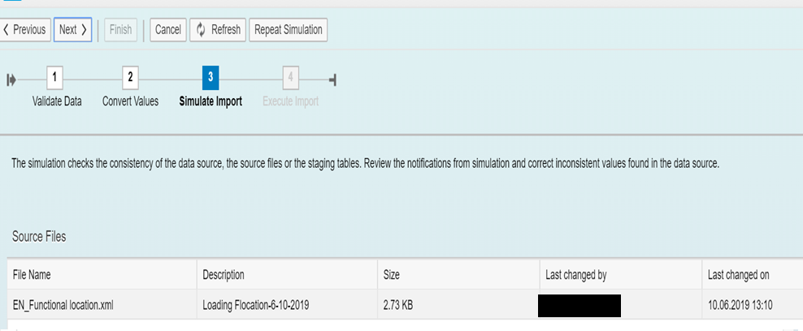
When we click on next in above screen it will move to below screen.

Slide 24
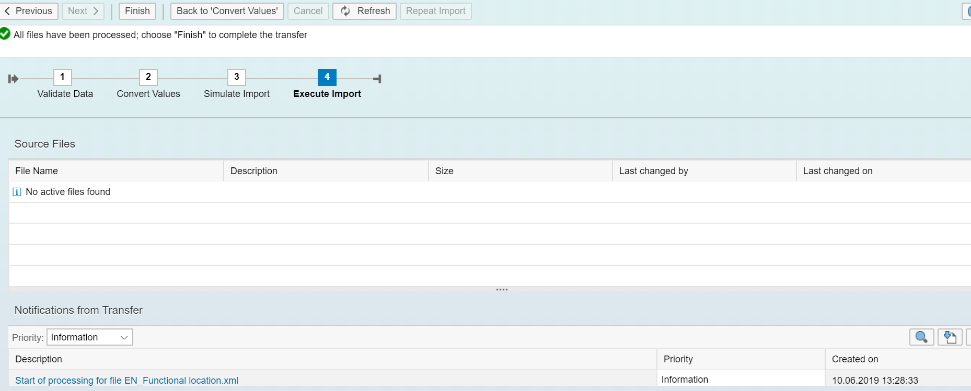
Click next it will go to below screen .Click finish if you don’t see any errors in below window.

Slide 25
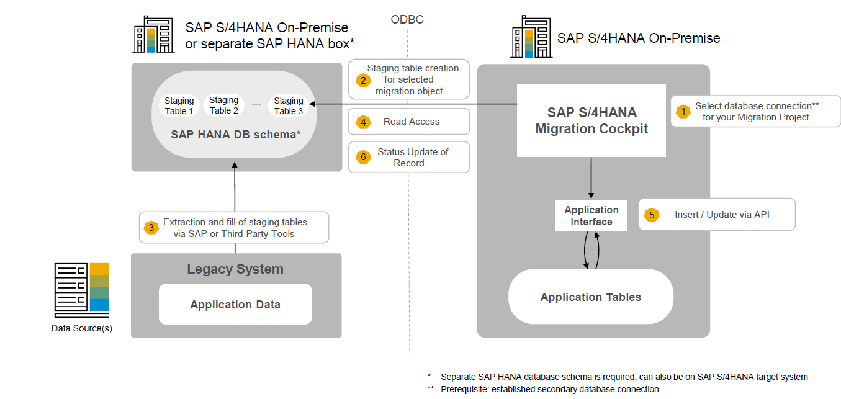
SAP S/4HANA Migration Cockpit -Transfer Data Using Staging Tables System Setup (On-Premise)

Slide 26
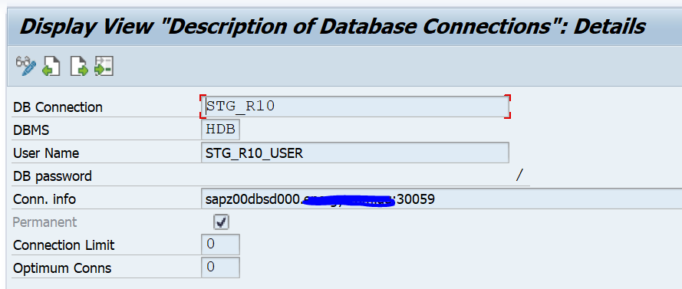
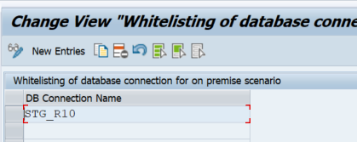
Transfer Data using Staging tables:
Using Staging tables in Migration Cockpit we can use Database Tables as a source for your Migration Project. These are called as ‘Staging Tables’, so you extract the data from the source system into these staging tables and import the data from there with the S/4HANA Migration Cockpit.
SAP Data Services as a method to populate Staging Database.
Create a Database Connection:
The first step in using Staging table is to create a Database Connection between S/4 and the schema where the Staging tables will reside .The Staging tables can exist in a remote database or in the target S/4HANA database (but in a separate Schema).
Go to transaction DBCO to create the database connection
White-List the connection in DMC_C_WL_DBCO_OP using transaction SM30

Slide 27
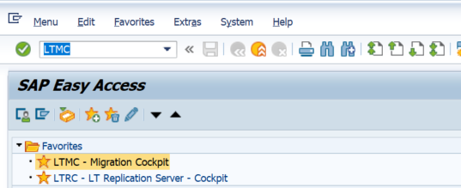
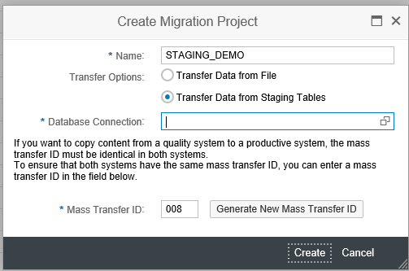
Creating a New Project for Data Migration
Go to Transaction LTMC – Migration Cockpit.
Click on Create New Migration Object and Select the Transfer Option – Transfer Data from Staging Tables.

Slide 28
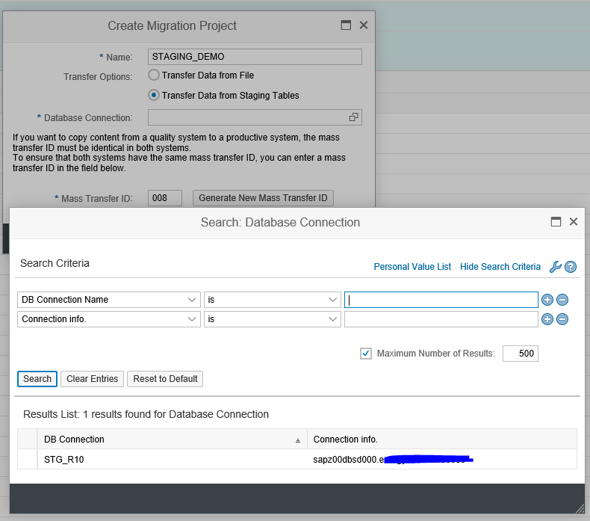
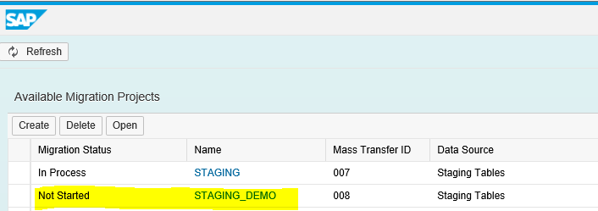
When you select the Database Connection from above screen, you can see the Database connection created in DBCO in previous Step.
Once you Select Click on Create. Select it and Save and the Migration Object is ready for use. I have named it as STAGING_DEMO .

Slide 29
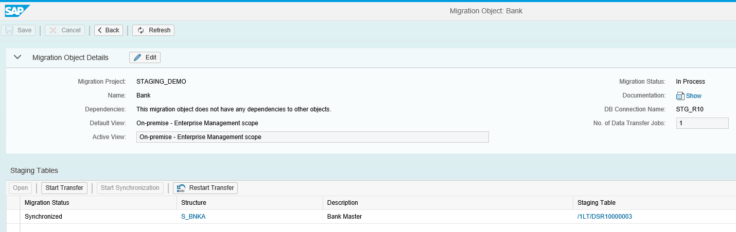
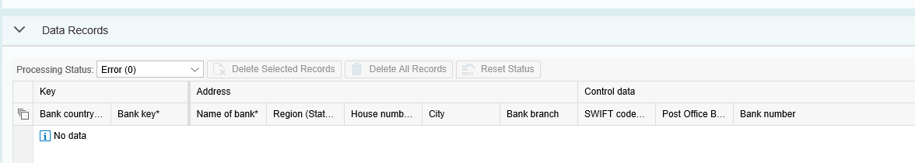
You can see all Conversion Objects are in Status Not Started. For this Demo I am using BANK Master Conversion Object. When you Click on BANK Conversion Object, a popup comes asking for copying the Conversion Object and Creating Staging tables.
Click OK.
Few things that you can see here:
Status – Synchronized
Structure – S_BNKA
Staging Table – /1LT/DSR10000003
Click on the table /1LT/DSR10000003 and you can see there is no records right now as below.

Slide 30
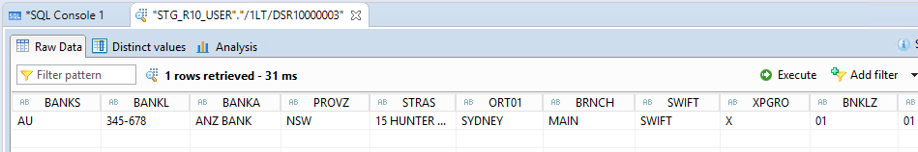
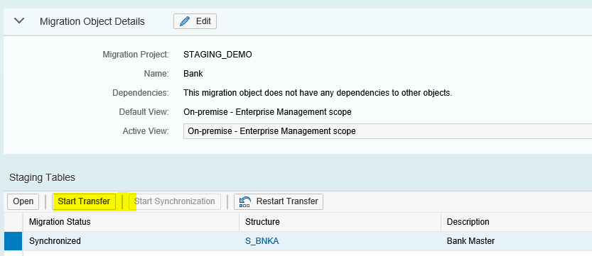
Insert data into staging table using BODS or S4 HANA table Upload methods
Load the data using Migration Cockpit
The last and main Step is to Migrate this Data into S/4 using the Migration Cockpit

Slide 31
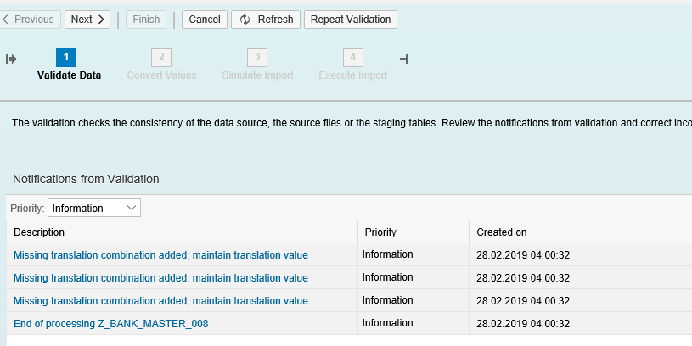
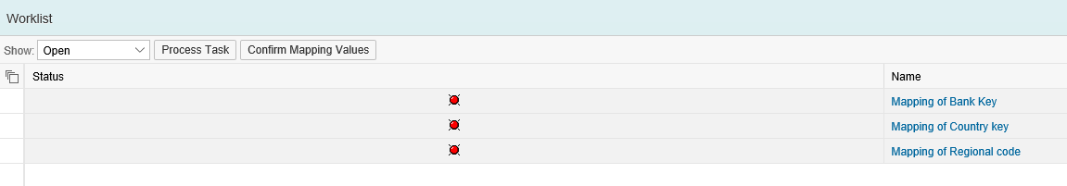
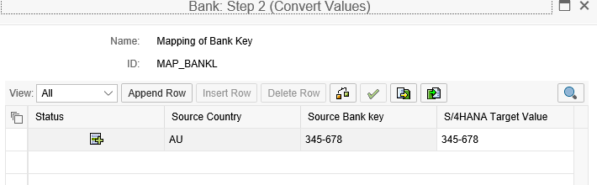
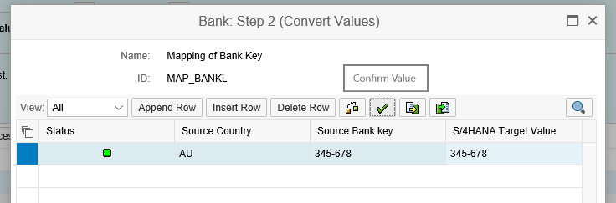
1. The Validate Data Step will come with Errors and Warnings .
2. Click Next and you see the Mapping errors. These are technically not errors, but S/4 just validates the value we are passing matches the help values for that field.
3. Click on each field and just Select and Press the key
4. The field turns Green Status. DO this for all the fields in red.

Slide 32
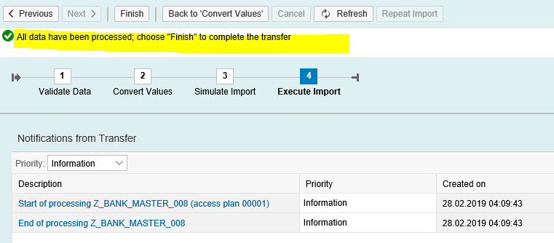
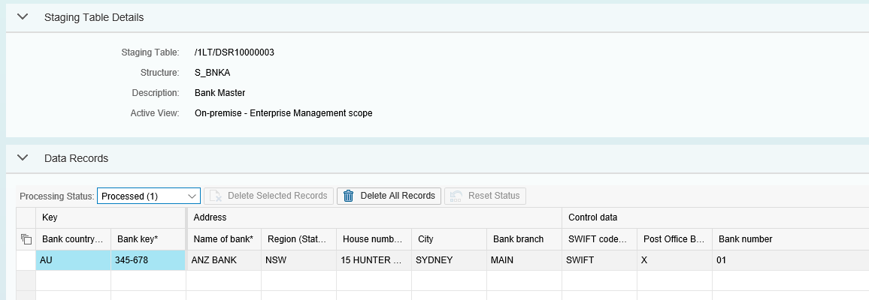
1. The simulate gives a Success message that the Data is good for Commit. You get the message at the Top: All data have been processed; choose “Finish” to complete the transfer
2. Click on Finish to Finish the Load and Commit the values. The load is finished and you can see the processed records in Migration Cockpit.

Slide 33
The following considerations when deciding on the most suitable approach for your project:
Consideration | Files | Staging Tables
Size Limit | 160MB limit for SAP S/4HANA Migration Cockpit .* | No Limit.
System Considerations | None. | Staging system uses an SAP HANA database.
Data Provisioning | Enter data manually in each Microsoft Excel XML file. | Fill tables manually or by using preferred tools (for example SAP Agile Data Preparation).

Slide 34
Preconfigured Business Objects (On-Premise 1809) Migration of Master and Transactional Data
Activity Price (restricted) | Exchange rate | Material consumption | Consent
Customer material | Material | Characteristic | G/L account
Maintenance item | Batch (if Batch is unique at material level) | Fixed asset (incl. balances and transactions) | Material long text
Activity Type | FI –Accounts payable open item | Material –extend existing record by new org level | Cost center
Equipment | Material BOM | Class | General task list
Maintenance plan | Batch (if Batch is unique at plant level) | Functional location | Material trade classification
Bank | FI –Accounts receivable open item | Material inspection setting | Customer
Equipment task list | Material classification | Condition contract | Inspection method
Master inspection characteristics | Cash memo record | Functional location task list | Pricing condition(general)
Bank account balance | FI –G/L account balance and open/line item | Material inventory balance | Customer (deprecated)
Inspection plan | Purchase order (only open PO) | QM selected set code
Pricing condition (purchasing) | Work center | Routing
Customer -extend existing record by new org levels | Purchase scheduling agreement | Sales contract
Internal order (restricted) | VC –Variant configuration profile | Sales order (only open SO)
Pricing condition (sales) | Purchasing contract | Software/Hardware constraint
Customer -extend existing record by new org levels (deprecated) | Work center | Sourcelist
Legal transaction | Purchasing info record-extend existing record | Supplier
Production version | Purchasing info record with conditions | Supplier (deprecated)
Profit center | QM/PM catalog code group/code | Supplier –extend existing record by new org levels
Supplier –extend existing record by new org levels (deprecated) | QM selected set

Slide 35
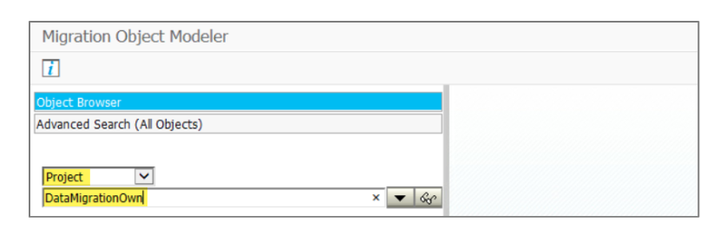
Working with LTMOM
LTMOM: Is used to Adding additional fields to a migration object.
To start the migration object modeler enter LTMOM TCode in the SAP GUI. NOTE: To run the necessary transaction your user needs the following role: SAP_CA_DMC_MC_DEVELOPER.
Customization offers in two ways:
Existing target structure attributes addition/modification in source structure/template
Creating new target structure/attributes (needs ABAP customization to the function module/ZBAPI)

Slide 36
THANK YOU

